Slide 1
Email Spam Prediction Keerthy.R

Slide 2
Introduction
This project focuses on building a Email Spam Prediction.
By analyzing email characteristics such as word count, character density and use of uppercase letters, the system aims to accurately classify emails as ham (legitimate) or spam (unwanted).
The goal is to:
Enhance email filtering efficiency
Reduce user exposure to scams and phishing
Automate spam detection with minimal false positives

Slide 3
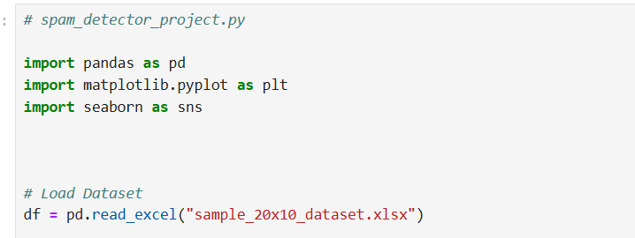
LOAD()
The load function typically refers to loading the dataset (emails) and optionally doing
some preprocessing.
load_data()

Slide 4
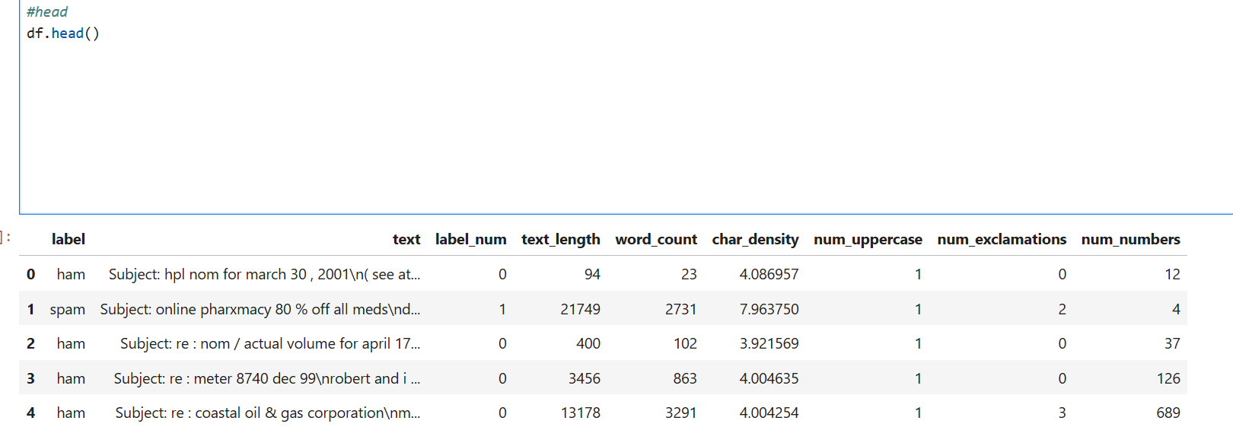
Head()
The head() function is employed to preview the first few rows of a dataset.
df.head()
This is a standard practice
to understand the structure and contents of the data before proceeding with further analysis or model training

Slide 5
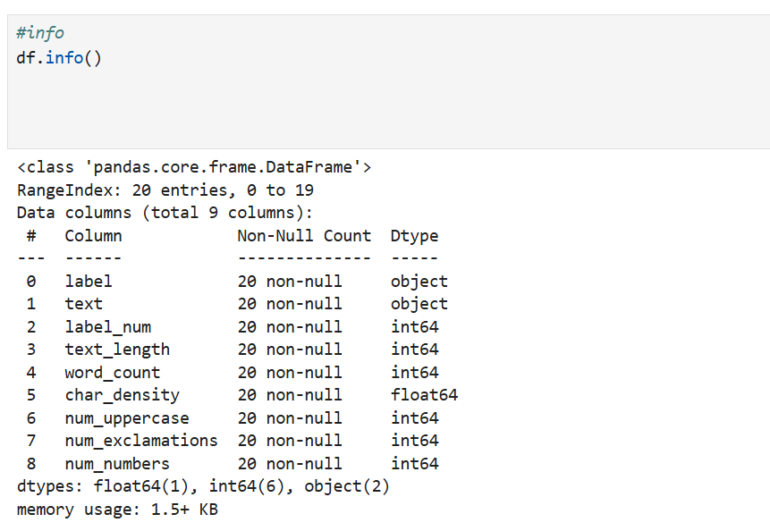
INFO ()
In a Spam Email
Prediction project,
the info() function is used to get a quick summary
of dataset
df.info()

Slide 6
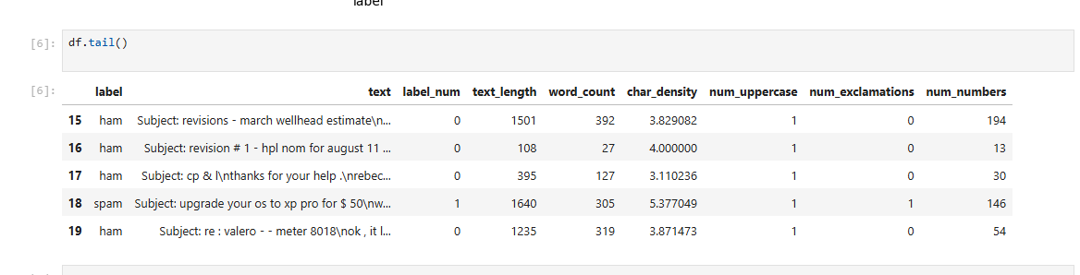
TAIL()
The tail() function in pandas is used to preview the last few rows of a dataset.
df.tail()

Slide 7
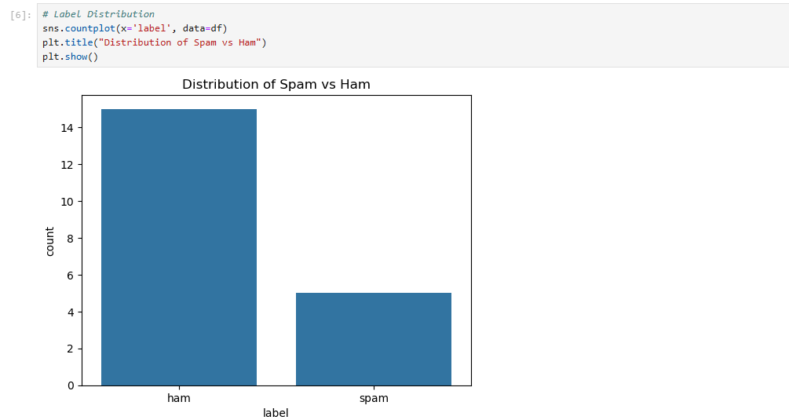
COUNTPLOT
The countplot() function from the Seaborn library provides a visual representation of the distribution of categorical variables, such as the labels 'spam' and 'ham' (non-spam), in dataset

Slide 8
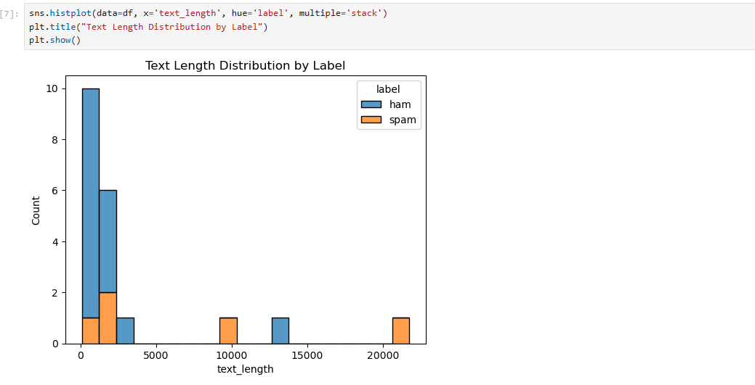
HISTPLOT
Histplot visualizes the distribution of email text lengths for both spam and ham (non-spam) messages.
Spam emails often have longer text lengths than ham emails.
Ham emails tend to cluster at shorter lengths, indicating they are generally more concise.

Slide 9
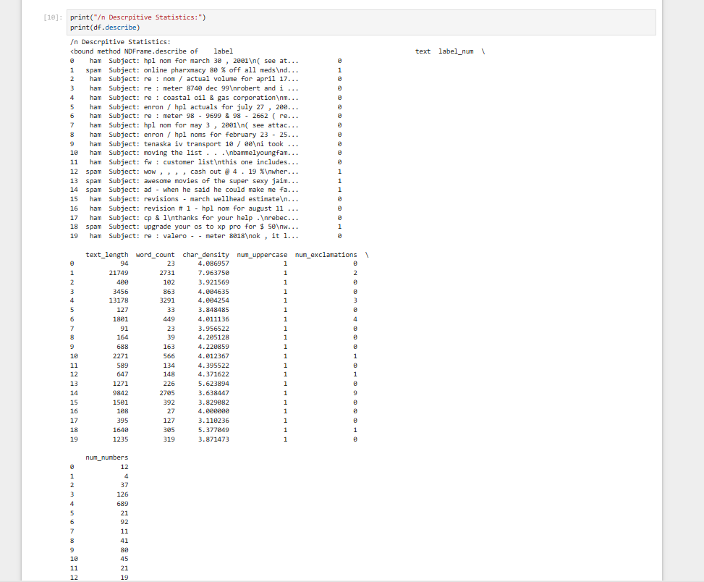
DESCRIPTIVE STATISTICS
The email spam dataset consists of messages labeled as either spam or ham (non-spam), accompanied by several engineered features such as text length, word count, character density, number of uppercase letters, exclamation marks, and digits. An initial analysis reveals that spam emails generally contain longer text, more words,where as Ham emails, on the other hand, are typically shorter and more concise.
df.describe()

Slide 10
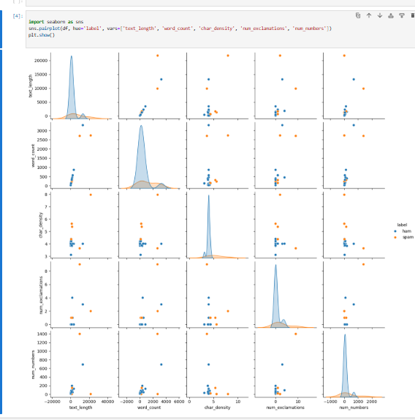
PAIRPLOT
A pairplot creates scatter plots for all combinations of numeric features and shows histograms on the diagonals.
It helps in:
Detecting patterns
Visualizing how features separate by label

Slide 11
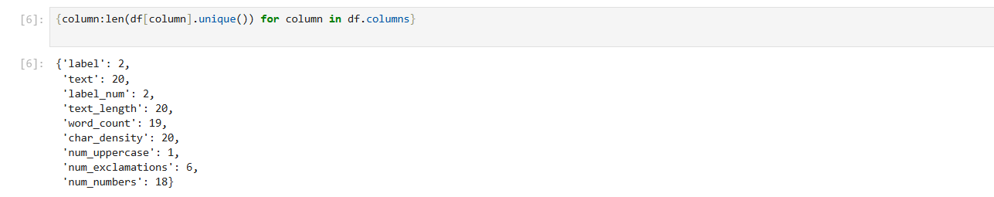
COLUMN
This gives you a list of all column names in the DataFrame.
This returns all the unique values that appear in the columns
{column: len(df[column].unique()) for column in df.columns}

Slide 12
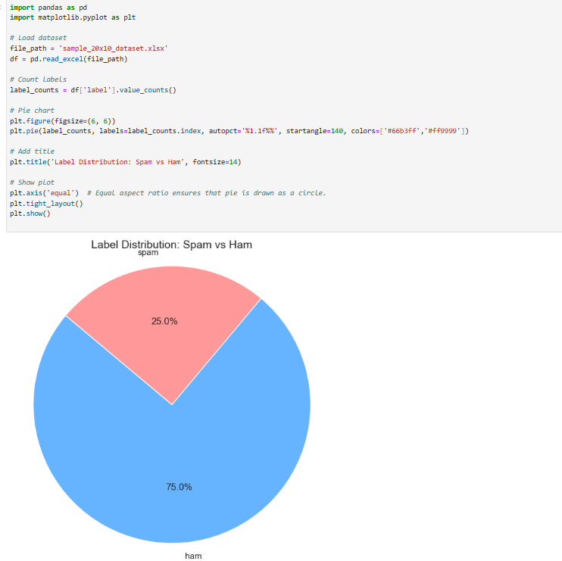
PIECHART
The pie chart illustrates the distribution of spam and non-spam emails within our dataset.
By visualizing the proportion of each category, we can quickly understand the balance between Ham emails and spam messages.
In this dataset, the chart shows that X% of the emails are labeled as spam, while Y% are non-spam (also called ham).

Slide 13
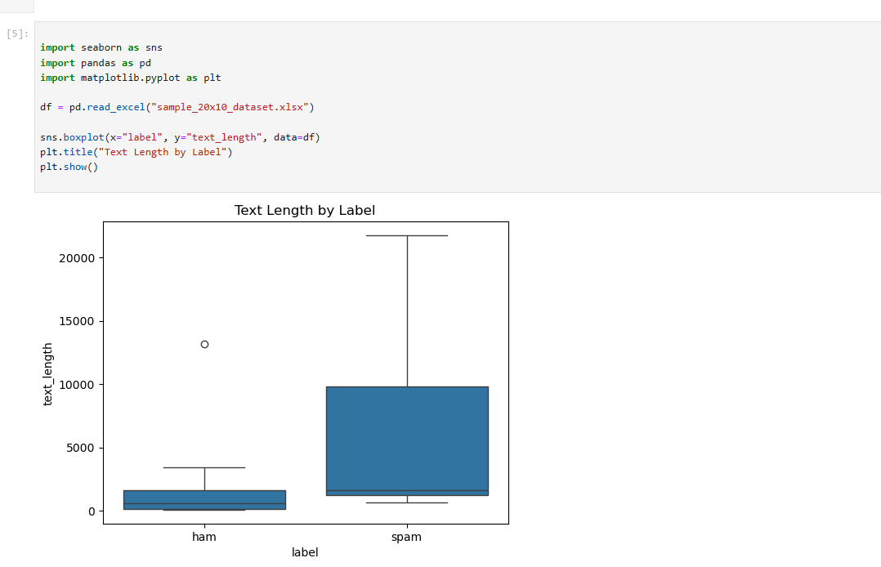
BOXPLOT
This boxplot compares the distribution of email text lengths between spam and non-spam (ham) emails in the dataset
By examining this plot, we can observe whether spam emails tend to be shorter or longer compared to Ham emails.

Slide 14
CONCLUSION
Visualizations like pie charts and boxplots revealed important insights, such as the distribution imbalance between spam and Non-spam emails, and differences in features like email text length.
Spam mail detection is essential for maintaining secure and efficient email communication. Through data analysis, including visualization , we identified key patterns that differentiate spam from Non-spam emails.

Slide 15


